Slide 1


Project Integration Management
School of Computer and Security Science
CSG 2344
Project Methods and Professionalism
ECU Copyright 2014 – CSG 2344 School of Computer and Security Science

Slide 2
Project Management –
Knowledge Areas
There are Ten Knowledge Management Areas.
(there used to only be 9)
Scope
Time
Cost
Quality
Communications
Risk
Human Resources
Procurement
Stakeholders
Integration
ECU Copyright 2014 – CSG 2344 School of Computer and Security Science

Slide 3
Learning Objectives
Describe an overall framework for project integration management as it relates to the other PM knowledge areas and the project life cycle
Explain the strategic planning process and apply different project selection methods
Explain the importance of creating a project charter to formally initiate projects
Discuss the process of creating a preliminary project scope statement
ECU Copyright 2014 – CSG 2344 School of Computer and Security Science

Slide 4
Learning Objectives (continued)
Describe project management plan development, and performing a stakeholder analysis to help manage relationships
Explain project execution, its relationship to project planning, the factors related to successful results, and tools and techniques to assist in project execution
Describe the process of monitoring and controlling project work
ECU Copyright 2014 – CSG 2344 School of Computer and Security Science

Slide 5
Learning Objectives (continued)
Understand the integrated change control process, planning for and managing changes on information technology projects, and developing and using a change control system
Explain the importance of developing and following good procedures for closing projects
Describe how software can assist in project integration management
ECU Copyright 2014 – CSG 2344 School of Computer and Security Science

Slide 6

The Key to Overall Project Success:
Good Project Integration Management
Project managers must coordinate all of the other knowledge areas throughout a project’s life cycle
Many new project managers have trouble looking at the “big picture” and want to focus on too many details
Project integration management is not the same thing as software integration
Project integration management occurs within the whole organisation
It involves “interface” management:
  Stakeholders
  Clients/Customers
  Project Team members
  Senior management
  Project opponents
  Other Project Managers
ECU Copyright 2014 – CSG 2344 School of Computer and Security Science

Slide 7
Project Integration Management Processes
Develop the project charter: working with stakeholders to create the document that formally authorizes a project—the charter
Develop the preliminary project scope statement: working with stakeholders, especially users of the project’s products, services, or results, to develop the high-level scope requirements and create a preliminary project scope statement
Develop the project management plan: coordinating all planning efforts to create a consistent, coherent document—the project management plan
ECU Copyright 2014 – CSG 2344 School of Computer and Security Science

Slide 8
Project Integration Management Processes (continued)
Direct and manage project execution: carrying out the project management plan by performing the activities included in it
Monitor and control the project work: overseeing project work to meet the performance objectives of the project
Perform integrated change control: coordinating changes that affect the project’s deliverables and organizational process assets
Close the project: finalizing all project activities to formally close the project
ECU Copyright 2014 – CSG 2344 School of Computer and Security Science

Slide 9
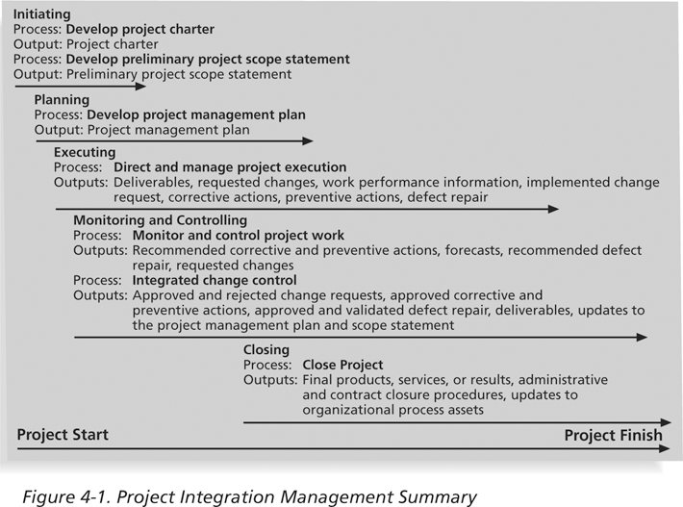
Project Integration Management Summary

Slide 10
What Went Wrong?
The Airbus A380 project was two years behind schedule in Oct. 2006, causing Airbus’ parent company to face an expected loss of $6.1 billion over the next four years
The project suffered from severe integration management problems, or “integration disintegration... when pre-assembled bundles containing hundreds of miles of cabin wiring were delivered from a German factory to the assembly line in France, workers discovered that the bundles, called harnesses, didn't fit properly into the plane. Assembly slowed to a near-standstill, as workers tried to pull the bundles apart and re-thread them through the fuselage.”*
*Matlack, Carol. “First, Blame the Software,” BusinessWeek Online (October 5, 2006).
ECU Copyright 2014 – CSG 2344 School of Computer and Security Science

Slide 11
Strategic Planning and Project Selection
Strategic planning involves determining long-term objectives, predicting future trends, and projecting the need for new products and services
Organizations often perform a SWOT analysis
  Analyzing Strengths, Weaknesses, Opportunities, and Threats
As part of strategic planning, organizations:
  Identify potential projects
  Use realistic methods to select which projects to work on
  Formalize project initiation by issuing a project charter
ECU Copyright 2014 – CSG 2344 School of Computer and Security Science

Slide 12
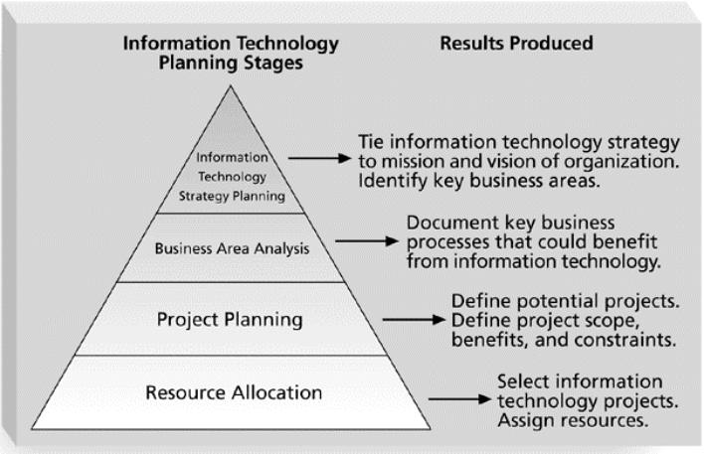
Information Technology Planning Process

Slide 13
Best Practice
Only one in seven product concepts comes to fruition
  Companies like Proctor & Gamble, Johnson and Johnson, Hewlett Packard, and Sony are consistently successful in NPD because they use a disciplined, systematic approach to NPD projects based on best practices
Four important forces behind NPD (New product development) success include the following:
  A product innovation and technology strategy for the business
  Resource commitment and focusing on the right projects, or solid portfolio management
  An effective, flexible and streamlined idea-to-launch process
  The right climate and culture for innovation, true cross-functional teams, and senior management commitment to NPD
ECU Copyright 2014 – CSG 2344 School of Computer and Security Science

Slide 14
Methods for Selecting Projects
There are usually more projects than available time and resources to implement them
Methods for selecting projects include:
  Focusing on broad organizational needs
  Categorizing information technology projects
  Performing net present value or other financial analyses
  Using a weighted scoring model
  Implementing a balanced scorecard
ECU Copyright 2014 – CSG 2344 School of Computer and Security Science

Slide 15
Focusing on Broad Organizational Needs
It is often difficult to provide strong justification for many IT projects, but everyone agrees they have a high value
“It is better to measure gold roughly than to count pennies precisely”
Three important criteria for projects:
  There is a need for the project
  There are funds available
  There’s a strong will to make the project succeed
ECU Copyright 2014 – CSG 2344 School of Computer and Security Science

Slide 16
Categorizing IT Projects
One categorization is whether the project addresses:
  A problem
  An opportunity
  A directive
Another categorization is how long it will take to do and when it is needed
Another is the overall priority of the project
ECU Copyright 2014 – CSG 2344 School of Computer and Security Science

Slide 17

Financial Analysis of Projects
Financial considerations are often an important consideration in selecting projects
Three primary methods for determining the projected financial value of projects
  Net present value (NPV) analysis
  Return on investment (ROI)
  Payback analysis
ECU Copyright 2014 – CSG 2344 School of Computer and Security Science

Slide 18
Net Present Value Analysis
Net present value (NPV) analysis is a method of calculating the expected net monetary gain or loss from a project by discounting all expected future cash inflows and outflows to the present point in time
Projects with a positive NPV should be considered if financial value is a key criterion
The higher the NPV, the better
ECU Copyright 2014 – CSG 2344 School of Computer and Security Science

Slide 19
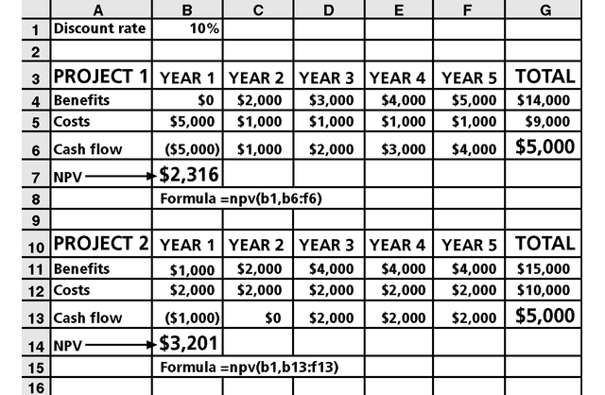
Net Present Value Example
Note that
totals are
equal, but
NPVs are
not because of the time value of money

Slide 20
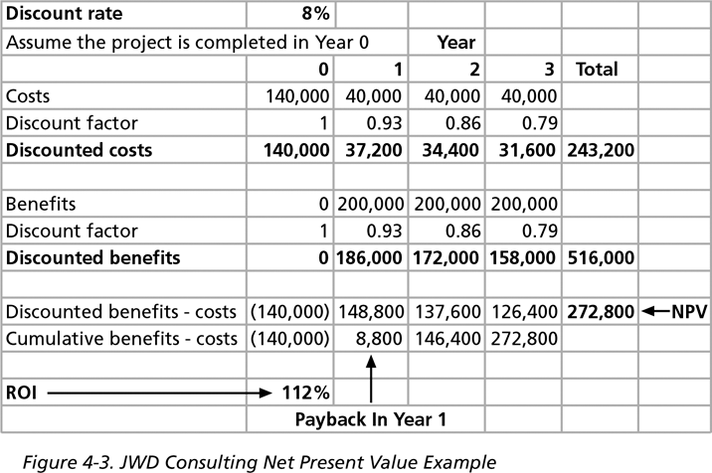
JWD Consulting NPV Example
Multiply
by the
discount
factor each
year, then take cum.
benefits –
costs to
get NPV

Slide 21
NPV Calculations
Determine estimated costs and benefits for the life of the project and the products it produces
Determine the discount rate (check with your organization on what to use)
Calculate the NPV (see text for details)
Note: Some organizations consider the investment year as year 0, while others start in year 1; some people enter costs as negative numbers, while others do not
  Check with your organization for their preferences
ECU Copyright 2014 – CSG 2344 School of Computer and Security Science

Slide 22
Return on Investment
Return on investment (ROI) is calculated by subtracting the project costs from the benefits and then dividing by the costs
  ROI = (total discounted benefits - total discounted costs) / discounted costs
The higher the ROI, the better
Many organizations have a required rate of return or minimum acceptable rate of return on investment for projects
Internal rate of return (IRR) can by calculated by finding the discount rate that makes the NPV equal to zero
ECU Copyright 2014 – CSG 2344 School of Computer and Security Science

Slide 23
Payback Analysis
Another important financial consideration is payback analysis
The payback period is the amount of time it will take to recoup, in the form of net cash inflows, the total dollars invested in a project
Payback occurs when the net cumulative discounted benefits equals the costs
Many organizations want IT projects to have a fairly short payback period
ECU Copyright 2014 – CSG 2344 School of Computer and Security Science

Slide 24
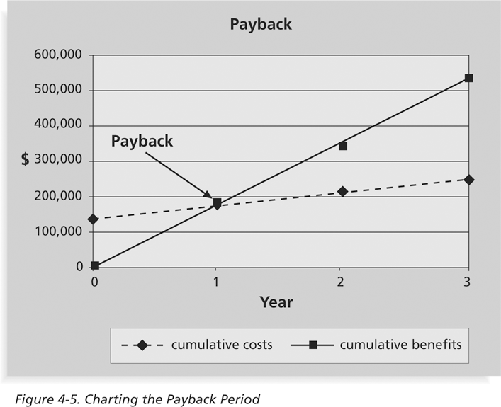
Charting the Payback Period

Slide 25
Implementing a Balanced Scorecard
Drs. Robert Kaplan and David Norton developed this approach to help select and manage projects that align with business strategy
A balanced scorecard:
  Is a methodology that converts an organization’s value drivers, such as customer service, innovation, operational efficiency, and financial performance, to a series of defined metrics
See www.balancedscorecard.org for more information
ECU Copyright 2014 – CSG 2344 School of Computer and Security Science

Slide 26
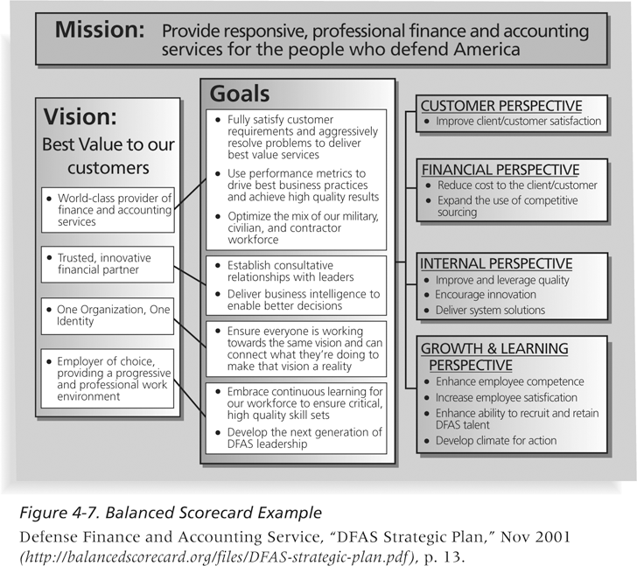
Balanced Scorecard Example

Slide 27
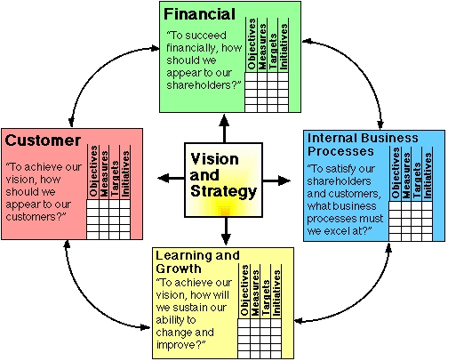
Balanced Scorecard

Slide 28
Why Firms Invest in Information Technology
Supports explicit business objectives
Has good internal rate of return
Supports implicit business objectives
Has a good net present value
Has a reasonable payback period
Used in response to competitive systems
Support management decision making
Meets budgetary constraints
High probability of achieving results
Good accounting rate of return
ECU Copyright 2014 – CSG 2344 School of Computer and Security Science

Slide 29

Remember
Organisation undertake project for one of the following reasons:
  Increase revenue
  Decrease costs
  Stay in business
ECU Copyright 2014 – CSG 2344 School of Computer and Security Science

Slide 30
Project Charters
After deciding what project to work on, it is important to let the rest of the organization know
A project charter is a document that formally recognizes the existence of a project and provides direction on the project’s objectives and management
Key project stakeholders should sign a project charter to acknowledge agreement on the need and intent of the project; a signed charter is a key output of project integration management
ECU Copyright 2014 – CSG 2344 School of Computer and Security Science

Slide 31
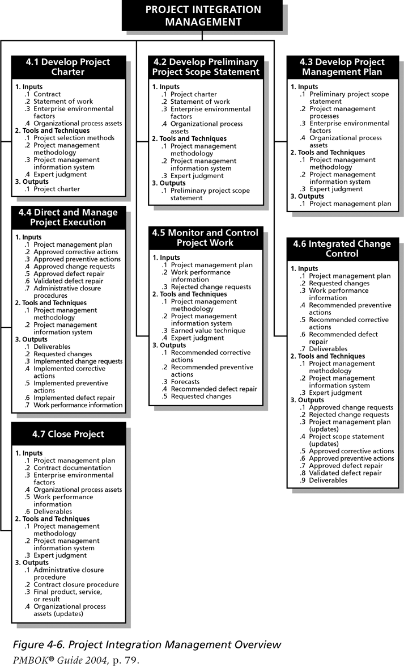
Project Integration Management Overview

Slide 32
Preliminary Scope Statements
A scope statement is a document used to develop and confirm a common understanding of the project scope
It’s important for preventing scope creep
  The tendency for project scope to keep getting bigger
It’s good practice to develop a preliminary or initial scope statement during project initiation and a more detailed scope statement as the project progresses
ECU Copyright 2014 – CSG 2344 School of Computer and Security Science

Slide 33
Project Management Plans
A project management plan is a document used to coordinate all project planning documents and help guide a project’s execution and control
Plans created in the other knowledge areas are subsidiary parts of the overall project management plan
ECU Copyright 2014 – CSG 2344 School of Computer and Security Science

Slide 34

Project Plan Framework
A Project Plan Attempts to answer the following questions
  What needs to be done
  Who will do the work
  When will they do the work
  How long will the work take
  How much will it cost
ECU Copyright 2014 – CSG 2344 School of Computer and Security Science

Slide 35
Project Plan Development
A project plan is a document used to coordinate all project planning documents
Its purpose is to guide project execution
Project plans assist the project manager in leading the project team and assessing project status
Project performance should be measured against a baseline plan
ECU Copyright 2014 – CSG 2344 School of Computer and Security Science

Slide 36
Attributes of Project Plans
Just as projects are unique, so are project plans
  Plans should be dynamic
  Plans should be flexible
  Plans should be updated as changes occur
  Plans should first and foremost guide project execution
ECU Copyright 2014 – CSG 2344 School of Computer and Security Science

Slide 37
Common Elements of a Project Management Plan
Introduction or overview of the project
Description of how the project is organized
Management and technical processes used on the project
Work to be done, schedule, and budget information
ECU Copyright 2014 – CSG 2344 School of Computer and Security Science

Slide 38
Key Components of a Project Plan
Project name
Brief Description
Management Objectives
Project Scope
Project Deliverables
Sponsor/Stakeholders
Organisational Charts
(Roles & responsibilities)
Project Controls
Risk Management
Project Resourcing
(People, technology, facilities)
Technical Processes
Major Work Packages
Assumptions & Risks
Project Administration
  Communications Plan
  Scope management Plan
  Quality Plan
  Change management Plan
  HR Plan
Project Schedule
  Summary
  Detailed
Project Budget
  Summary
  Detailed
Last updated S1, 2008
ECU Copyright 2014 – CSG 2344 School of Computer and Security Science

Slide 39
Stakeholder Analysis
A stakeholder analysis documents important (often sensitive) information about stakeholders such as:
  Stakeholders’ names and organizations
  Roles on the project
  Unique facts about stakeholders
  Level of influence and interest in the project
  Suggestions for managing relationships
ECU Copyright 2014 – CSG 2344 School of Computer and Security Science

Slide 40
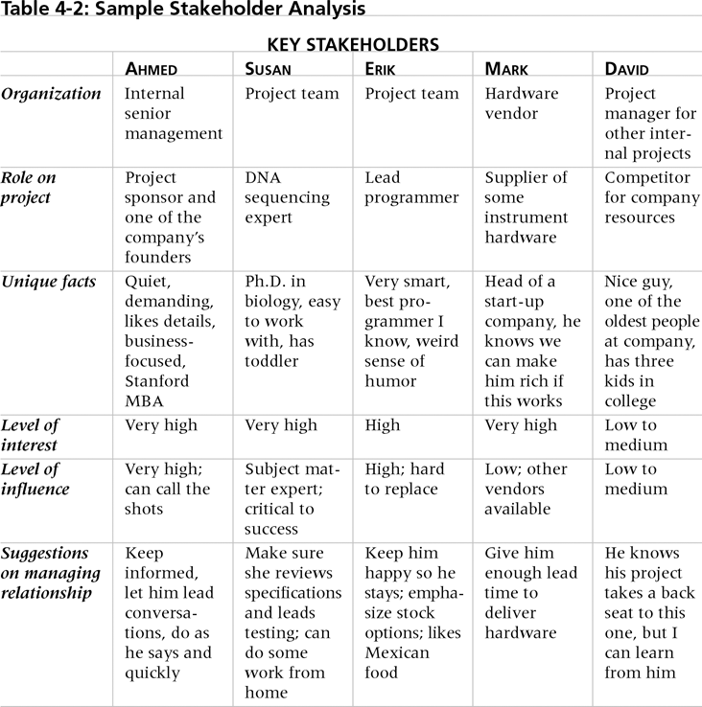
Sample Stakeholder Analysis

Slide 41
Project Execution
Project execution involves managing and performing the work described in the project management plan
The majority of time and money is usually spent on execution
The application area of the project directly affects project execution because the products of the project are produced during execution
ECU Copyright 2014 – CSG 2344 School of Computer and Security Science

Slide 42
Coordinating Planning and Execution
Project planning and execution are intertwined and inseparable activities
Those who will do the work should help to plan the work
Project managers must solicit input from the team to develop realistic plans
ECU Copyright 2014 – CSG 2344 School of Computer and Security Science

Slide 43
Providing Leadership and a Supportive Culture
Project managers must lead by example to demonstrate the importance of creating and then following good project plans
Organizational culture can help project execution by:
  Providing guidelines and templates
  Tracking performance based on plans
Project managers may still need to break the rules to meet project goals, and senior managers must support those actions
ECU Copyright 2014 – CSG 2344 School of Computer and Security Science

Slide 44
Important Skills for Project Execution
General management skills like leadership, communication, and political skills
Product, business, and application area skills and knowledge
Use of specialized tools and techniques
ECU Copyright 2014 – CSG 2344 School of Computer and Security Science

Slide 45
Project Execution Tools and Techniques
Project management methodology: many experienced project managers believe the most effective way to improve project management is to follow a methodology that describes not only what to do in managing a project, but how to do it
Project management information systems: there are hundreds of project management software products available on the market today, and many organizations are moving toward powerful enterprise project management systems that are accessible via the Internet
ECU Copyright 2014 – CSG 2344 School of Computer and Security Science

Slide 46
Monitoring and Controlling Project Work
Changes are inevitable on most projects, so it’s important to develop and follow a process to monitor and control changes
Monitoring project work includes collecting, measuring, and disseminating performance information
Two important outputs of monitoring and controlling project work include recommended corrective and preventive actions
ECU Copyright 2014 – CSG 2344 School of Computer and Security Science

Slide 47
Media Snapshot
The 2002 Olympic Winter Games and Paralympics took five years to plan and cost more than $1.9 billion. PMI awarded the Salt Lake Organizing Committee (SLOC) the Project of the Year award for delivering world-class games.
Four years before the Games began, the SLOC used a Primavera software-based system with a cascading color-coded WBS to integrate planning… The SLOC also used an Executive Roadmap, to keep executives apprised of progress. Activities were tied to detailed project information within each department’s schedule. A 90-day highlighter showed which managers were accountable for each integrated activity.
Fraser Bullock, SLOC Chief Operating Officer and Chief, said, “We knew when we were on and off schedule and where we had to apply additional resources. The interrelation of the functions meant they could not run in isolation—it was a smoothly running machine.”*
Last updated S1, 2008
ECU Copyright 2014 – CSG 2344 School of Computer and Security Science

Slide 48
Integrated Change Control
Three main objectives are:
  Influencing the factors that create changes to ensure that changes are beneficial
  Determining that a change has occurred
  Managing actual changes as they occur
A baseline is the approved project management plan plus approved changes
ECU Copyright 2014 – CSG 2344 School of Computer and Security Science

Slide 49
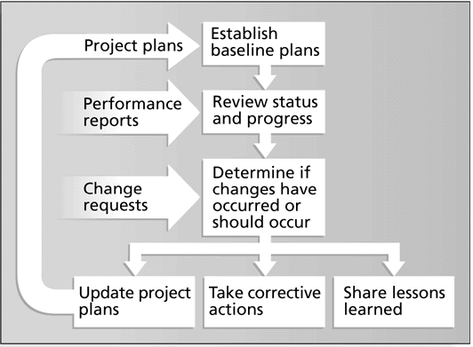
Integrated Change Control Process
Last updated S1, 2008

Slide 50
Change Control on Information Technology Projects
Former view: the project team should strive to do exactly what was planned on time and within budget
Problem: stakeholders rarely agreed up-front on the project scope, and time and cost estimates were inaccurate
Modern view: project management is a process of constant communication and negotiation
Solution: changes are often beneficial, and the project team should plan for them
ECU Copyright 2014 – CSG 2344 School of Computer and Security Science

Slide 51

Change Control System
A formal, documented process that describes when and how official project documents and work may be changed
Describes who is authorized to make changes and how to make them
ECU Copyright 2014 – CSG 2344 School of Computer and Security Science

Slide 52
Making Timely Changes
Some CCBs only meet occasionally, so it may take too long for changes to occur
Some organizations have policies in place for time-sensitive changes
  “48-hour policy” allows project team members to make decisions, then they have 48 hours to reverse the decision pending senior management approval
  Delegate changes to the lowest level possible, but keep everyone informed of changes
ECU Copyright 2014 – CSG 2344 School of Computer and Security Science

Slide 53
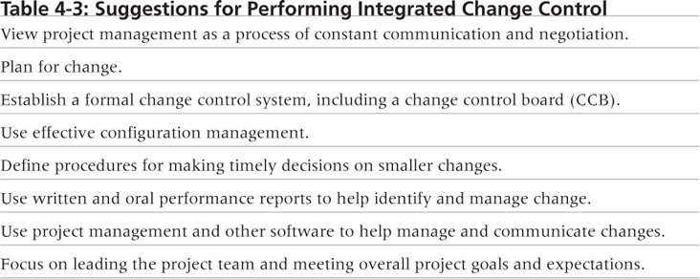
Suggestions for Performing Integrated Change Control
ECU Copyright 2014 – CSG 2344 School of Computer and Security Science

Slide 54
Closing Projects
To close a project, you must finalize all activities and transfer the completed or cancelled work to the appropriate people
Main outputs include:
  Administrative closure procedures
  Contract closure procedures
  Final products, services, or results
  Organizational process asset updates
ECU Copyright 2014 – CSG 2344 School of Computer and Security Science

Slide 55

Chapter Summary
Project integration management includes:
  Developing a project charter
  Developing a preliminary project scope statement
  Developing a project management plan
  Directing and managing project execution
  Monitoring and controlling project work
  Performing integrated change control
  Closing the project
ECU Copyright 2014 – CSG 2344 School of Computer and Security Science

